Slide 1
Visceral
Leishmaniasis
Ram Balak Mahto
Guest faculty
Zoology department
v.s.j college Rajnagar Madhubani
Class B.Sc 1st yr. Paper 1, group-A 7908055676

Slide 2
Visceral Leishmaniasis
1903
1920
1931
William Leishman
Pentavalent antimony
Experimental transmission
Leishmania donovani (Complex)
L.d. archibaldi - L.d.chagasi - L.d.donovani - Ld.infantum

Slide 3
VL - Clinical Manifestation
Variable - Incubation 3-100+ weeks
Lowgrade fever
Hepato-splenomegaly
Bone marrow hyperplasia
Anemia, Leucopenia & Cachexia
Hypergammaglobulinnemia
Epistaxis , Proteinuria, Hematuria

Slide 4
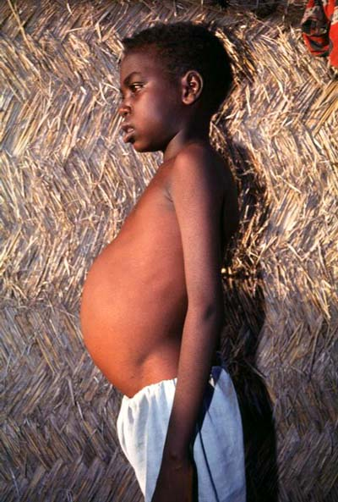
Profile view of a teenage boy suffering from visceral leishmaniasis. The boy exhibits splenomegaly, distended abdomen and severe muscle wasting.

Slide 5
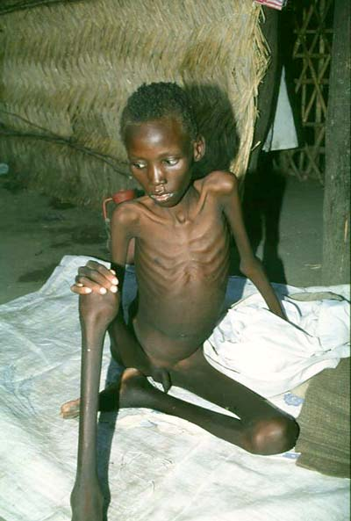
A 12-year-old boy suffering from visceral leishmaniasis. The boy exhibits splenomegaly and severe muscle wasting.

Slide 6
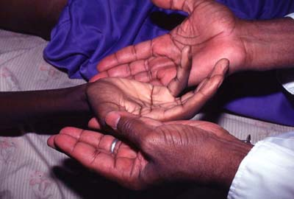
Jaundiced hands of a visceral leishmaniasis patient.

Slide 7
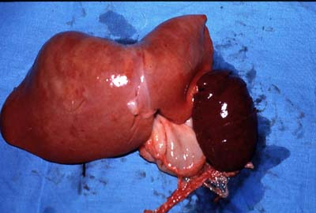
Enlarged spleen and liver in an autopsy of an infant dying of visceral leishmaniasis.

Slide 8
Post Kala Azar Dermal Leishmanoid
Normally develops <2 years after recovery
Recrudescence
Restricted to skin
Rare but varies geographically

Slide 9
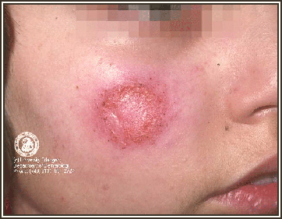
Cutaneous leishmaniasis of the face.

Slide 10
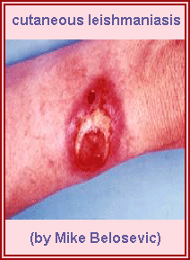
A cutaneous leishmaniasis lesion on the arm.

Slide 11
INFECTION
Sub-clinical or inapparent infection
Recovery Death
Immune to reinfection Concurrent infection
PKDL

Slide 12
Diagnosis
Clinical signs & symptoms
Hypergammaglobulinemia
ELISA/Formol gel
Bone marrow biopsy
Spleen or liver biopsy
Culture & Histology

Slide 13
Speciation
Similar morphology
Isoenzyme profiles - Zymodemes
Monoclonal antibodies
DNA hybridisation - PCR

Slide 14
Treatment
Good nursing
Diet
Antibiotics
Pentavalent antimony
Pentamidine
New drugs - New delivery

Slide 15
Control
Vector control
Reservoir control
Treatment of active cases
Vaccination

